Slide 1
Comparative analysis between Alumina vs Zirconia Dielectric Resonator Antenna
Name of Scholars
Adhil Anil Pillai Om Prakash Shinde
Bagavath Kumar P. Jyotilipsa Mishra
UG
Pillai College of Engineering (Autonomous)
Dr. Ameet Mehta (Faculty Research Guide)

Slide 2




INTRODUCTION & MOTIVATION
Limitations of Conventional Microstrip Patches
The Dielectric Resonator Antenna (DRA) Paradigm
Metallic microstrip antennas are widely deployed due to planar simplicity and low profile.
However, skin-depth conduction resistance (I²R ohmic dissipation) and dielectric surface-wave propagation severely degrade radiation efficiency.
DRA (Dielectric Resonator Antenna) replaces metallic radiators with low-loss technical ceramic resonators, where radiation occurs via internal electromagnetic displacement currents rather than metallic conduction currents, minimizing ohmic losses.
Four Degrees of Freedom in DRA Engineering
Objective
Dielectric Material: Permittivity (εr) dictates size scaling & radiation Q-factor.
Analysis of conventional microstrip patch at same resonanant frequency
Resonator Geometry: Rectangular, cylindrical, or hollow-core shapes.
Compare Alumina and Zirconia cylindrical DRAs for miniaturization and performance.
Feeding Mechanism: Microstrip line, coaxial probe, or aperture slot coupling.

Slide 3
LITERATURE REVIEW: FOUNDATIONS (PAPERS 1–4)
Foundations & Feeding Techniques
Dielectric Constant & Size-Bandwidth Trade-Off
Scope: Comprehensive survey establishing analytical modal theory, feed-coupling mechanisms, and dielectric miniaturization approaches.
Core Contribution: Formalized dielectric waveguide boundary conditions, higher-order mode excitation, and circularly polarized MIMO arrays.
Research Takeaway: Proved that slot-coupled feeding provides superior back-isolation and magnetic dipole excitation purity.
Scope: Systematic empirical investigation on cylindrical DRAs across varying dielectric constants.
Core Contribution: Demonstrated that higher permittivity (εr) achieves significantly better directivity but decreases the bandwidth
Research Takeaway: Establishes the foundational trade-off: high permittivity reduces antenna dimensions but limits impedance bandwidth.
Rectangular DRA for 5G Frequency Bands
Perforated Geometry Optimization
Scope: Full-wave 3D HFSS modeling of rectangular ceramic blocks for sub-6 GHz 5G spectrum.
Core Contribution: Validated that simple orthogonal geometries produce highly predictable resonant modes and ease fabrication tolerances.
Research Takeaway: Confirmed rectangular profiles suffer from limited bandwidth unless assisted by modified feeding or geometric perturbation.
Scope: Introduced periodic microscopic perforations into dielectric resonator volumes.
Core Contribution: Synthesized effective permittivity gradients, lowering loaded Q and exciting higher-order modes without physical enlargement.
Research Takeaway: Structural modifications successfully mitigate the size-bandwidth penalty, inspiring non-uniform geometry designs.
Foundational Theoretical & Geometrical Evolution in Microwave Ceramic Engineering

Slide 4
LITERATURE REVIEW: FOUNDATIONS (PAPERS 1–4)
Hollow Core Resonator Topologies
Dielectric Ring Loading & Pattern Symmetry
Scope: Investigated selective material evacuation from the central core of cylindrical ceramic DRAs.
Core Contribution: Reduced internal stored energy concentration, expanding bandwidth, and boosting efficiency.
Research Takeaway: Demonstrated that modifying internal field volume relieves dielectric impedance constraints.
Research Takeaway: Demonstrated that modifying internal field volume relieves dielectric impedance constraints.
Core Contribution: Significantly enhanced broadside boresight gain and radiation symmetry while suppressing cross-polarization levels.
Research Takeaway: Parasitic dielectric boundaries guide radiation lobes, though introducing structural multi-component assembly challenges.
5G/6G Phased Arrays & LTCC Integration
Machine-Learning-Assisted DRA Optimization
Scope: State-of-the-art review on mmWave DRA arrays and Low-Temperature Co-fired Ceramic (LTCC) system-on-package front-ends.
Core Contribution: Characterized beam-steering capabilities, mutual coupling suppression, and integrated feeding networks.
Research Takeaway: Marks the research evolution from isolated single-element radiators toward integrated multi-antenna arrays.
Scope: Implemented Artificial Neural Networks (ANN), Random Forest, and XGBoost machine-learning surrogate models.
Core Contribution: Predicted resonance frequencies and S-parameter dips with >97% accuracy, bypassing computationally heavy 3D EM full-wave sweeps.
Research Takeaway: Validated AI-assisted predictive modelling as the future methodology for rapid dimensional synthesis.

Slide 5





RESEARCH GAP & INVESTIGATION METHODOLOGY
1. Isolated Parameter Sweeps
Stage 1: Metallic Circular Patch MSA Analysis
Prior literature predominantly isolates single variables (e.g., shape tuning alone or material substitution alone). Holistic co-evaluation of radiating mechanisms, permittivity scaling, and multi-mode excitation under identical bounds is rarely performed.
Objective: Analysis of conventional microstrip patch at 5.80 GHz resonance to isolate the transition from conduction currents to displacement currents under identical ground and feed conditions.
2. Size-Bandwidth Bottleneck
Stage 2: Alumina & Zirconia Cylindrical DRAs
High-permittivity materials provide dramatic volumetric compression but invariably restrict impedance bandwidth. Existing solutions rely on complex internal hollows or fragile perforations that drastically increase manufacturing costs.
Objective: Design Alumina (εr = 9.8) and Zirconia (εr ≈ 30) cylindrical DRAs and compare them with the metal patch and with each other
3. Sub-6 GHz Ceramic Scarcity
Experimental Evaluation Criteria
• S₁₁ Matching Depth (dB)
• -10 dB Fractional Bandwidth (%)
• Realized Peak Gain (dBi)
• Radiation Efficiency (%)
• Volumetric Miniaturization (mm³)
Current academic publications heavily concentrate on mmWave 5G/6G bands (>28 GHz), creating a clear shortage of compact ceramic antenna designs optimized for the widely utilized sub-10 GHz and 2.4 GHz ISM bands.

Slide 6
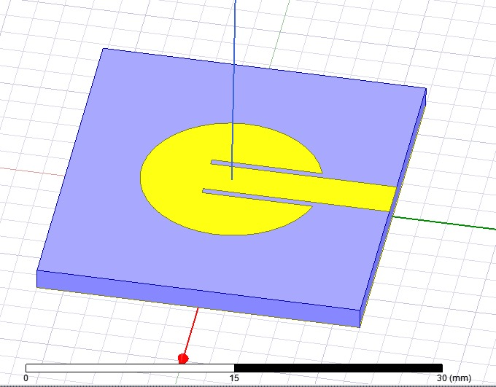
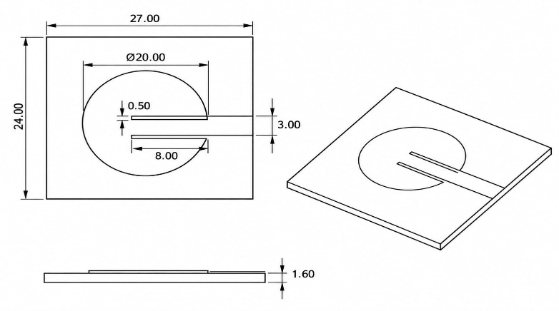
METAL PATCH: REFERENCE BASELINE DESIGN
Baseline Reference Configuration
A planar circular microstrip patch antenna is designed and optimized in Ansys HFSS to establish the conventional baseline at the targeted 5.80 GHz ISM operating band.
Radiation occurs via fringing electric fields established between the conducting copper patch and ground plane across the dielectric substrate layer.
Parameter | Baseline Specification | Design Notes
Target Operating Frequency | 5.80 GHz | ISM Band Center
Substrate Material | FR-4 | Standard planar RF laminate
Substrate Permittivity (εr) | 4.40 | Dielectric carrier layer
Feeding Method | Microstrip Inset Feed | 50 Ω transmission line matching
THE HFSS SIMULATION MODEL
DIMENSIONED VIEWS OF CIRCULAR MSA (MM)

Slide 7
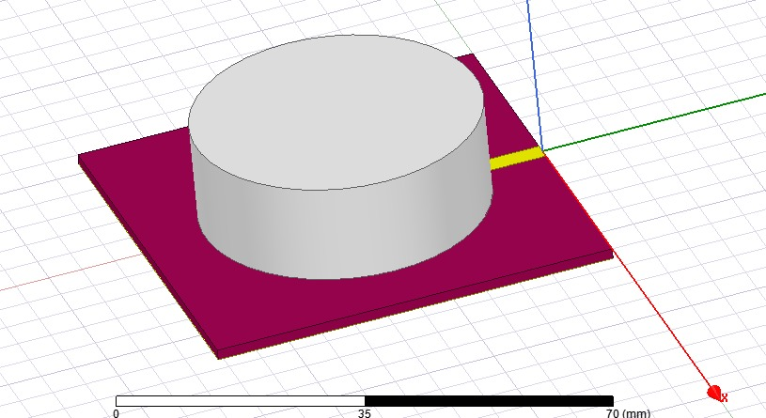
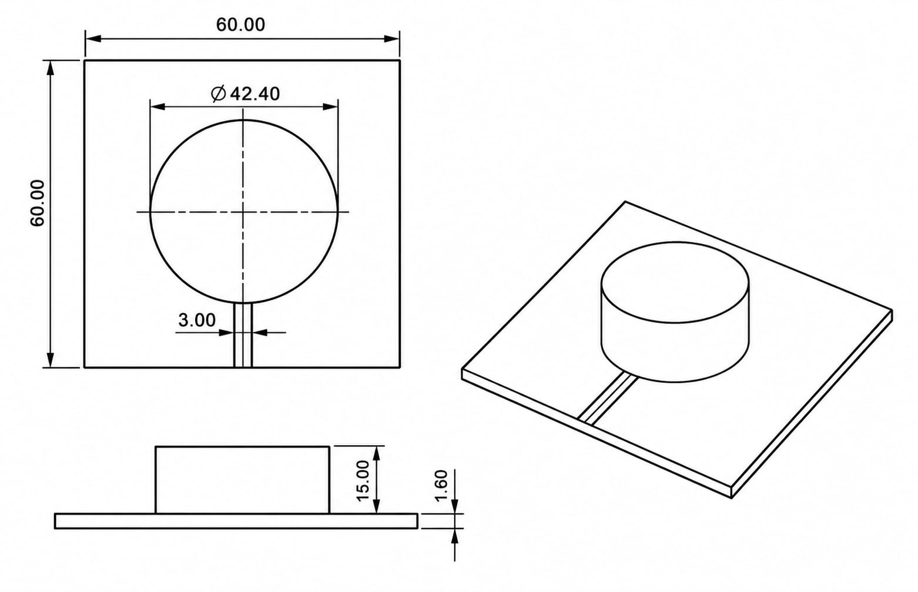
ALUMINA CDRA: MATERIAL & GEOMETRIC DESIGN
Why Alumina (Al₂O₃)?
Alumina has a relative permittivity of εr = 9.8, about 2.2× the FR-4 baseline (εr = 4.4). Because guided wavelength scales as λg ∝ 1/√εr, the radiator shrinks and radiation occurs via displacement currents.
Cylindrical DRA (CDRA) Geometry
A plain cylindrical resonator is excited with the help of a microstrip fees. The simple geometry is easy to fabricate and gives predictable resonance, forming the DRA baseline before any shape tuning.
THE HFSS SIMULATION MODEL
Design Parameter | Alumina CDRA
Relative Permittivity (εr) | 9.8
Dielectric Loss Tangent | 0.001
Target Resonant Frequency | 5.80 GHz
DIMENSIONED VIEWS OF THE ALUMINA CDRA (MM)

Slide 8
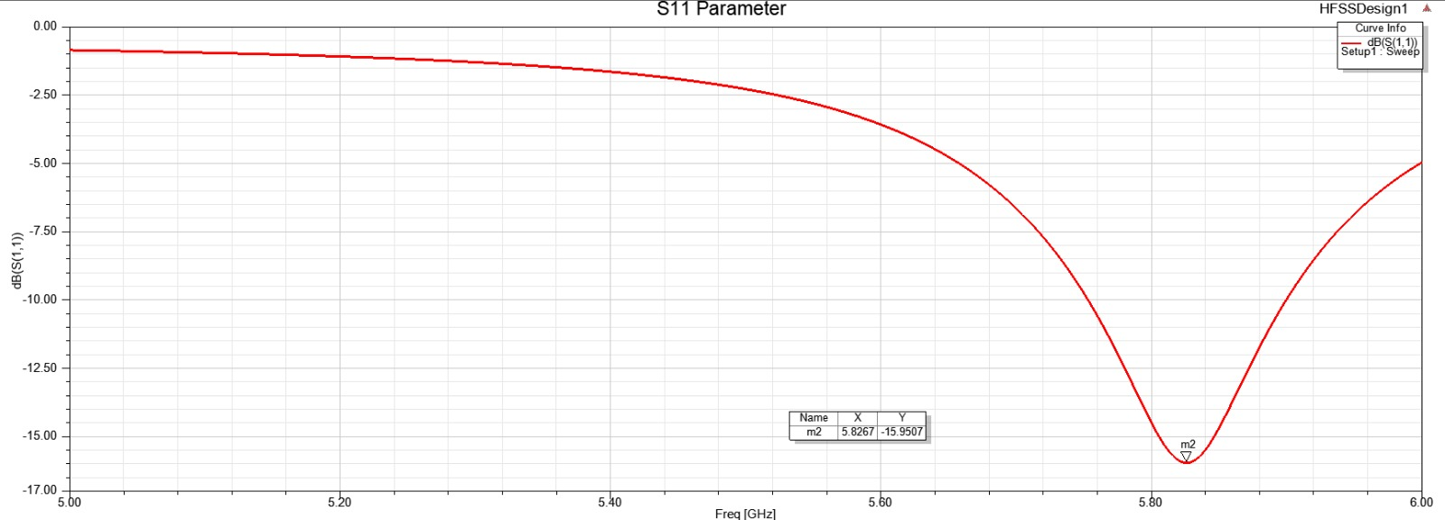
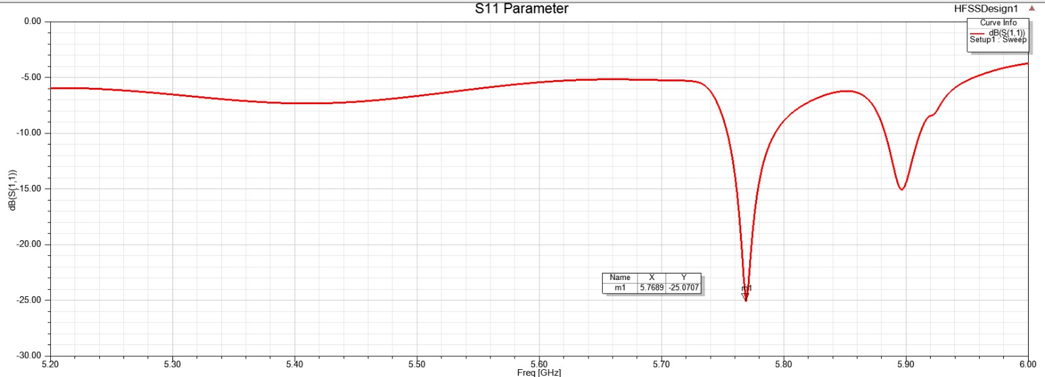
METAL vs ALUMINA CDRA: S11
Metal Patch (FR-4, εr = 4.4)
Alumina CDRA (εr = 9.8)

Slide 9
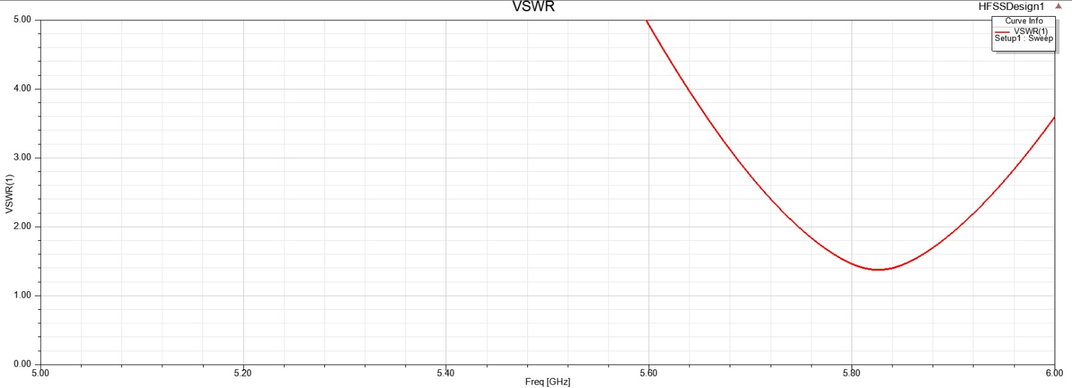
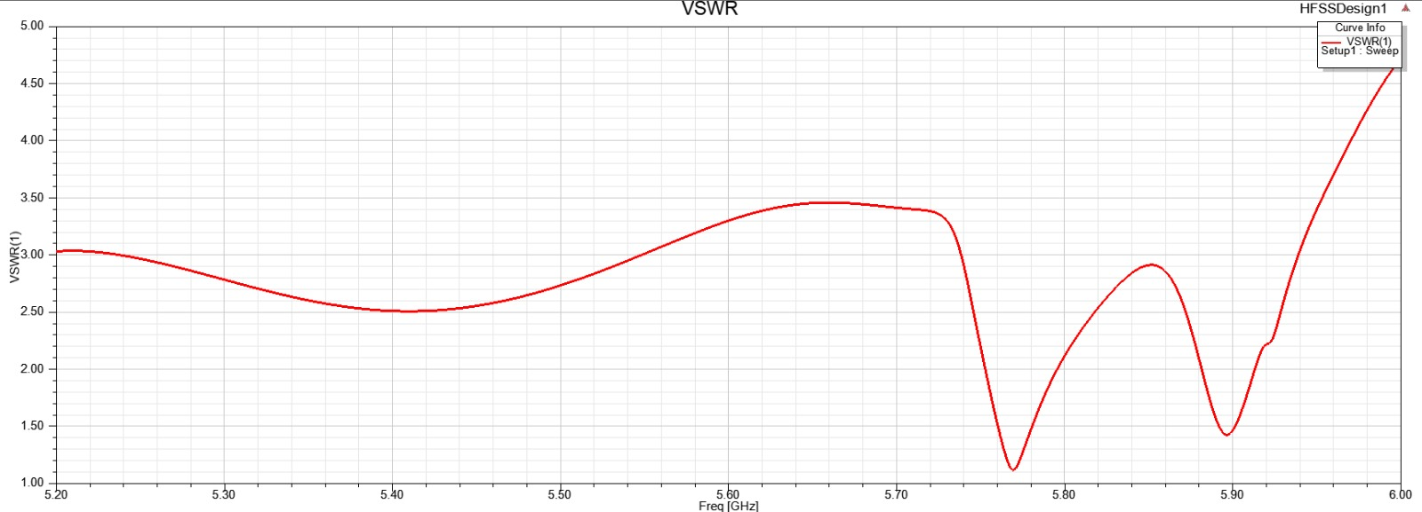
METAL vs ALUMINA CDRA: VSWR
Metal Patch (FR-4, εr = 4.4)
Alumina CDRA (εr = 9.8)

Slide 10
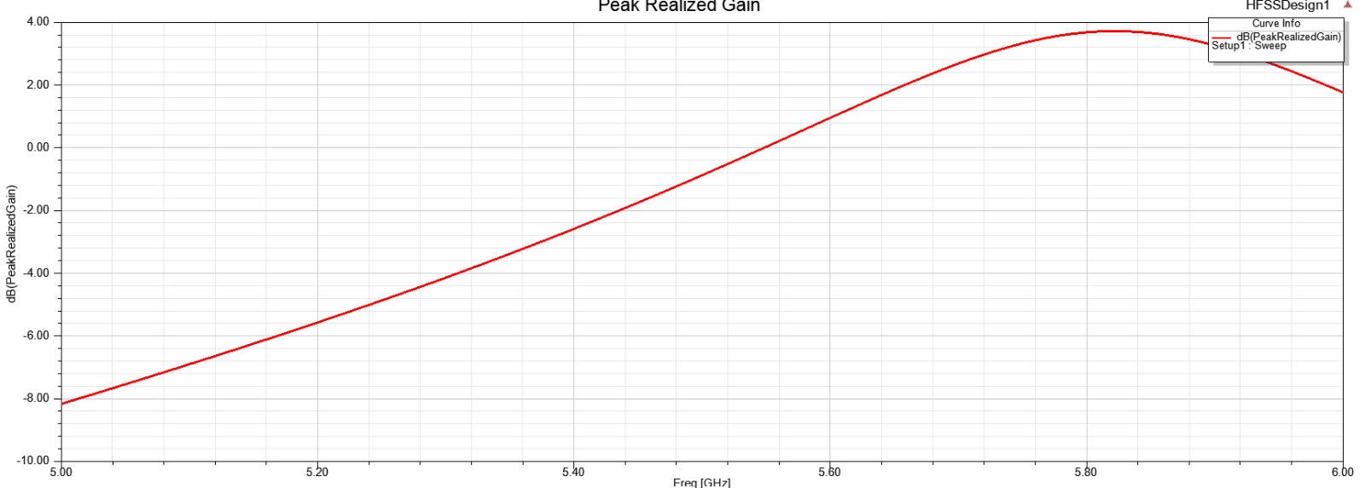
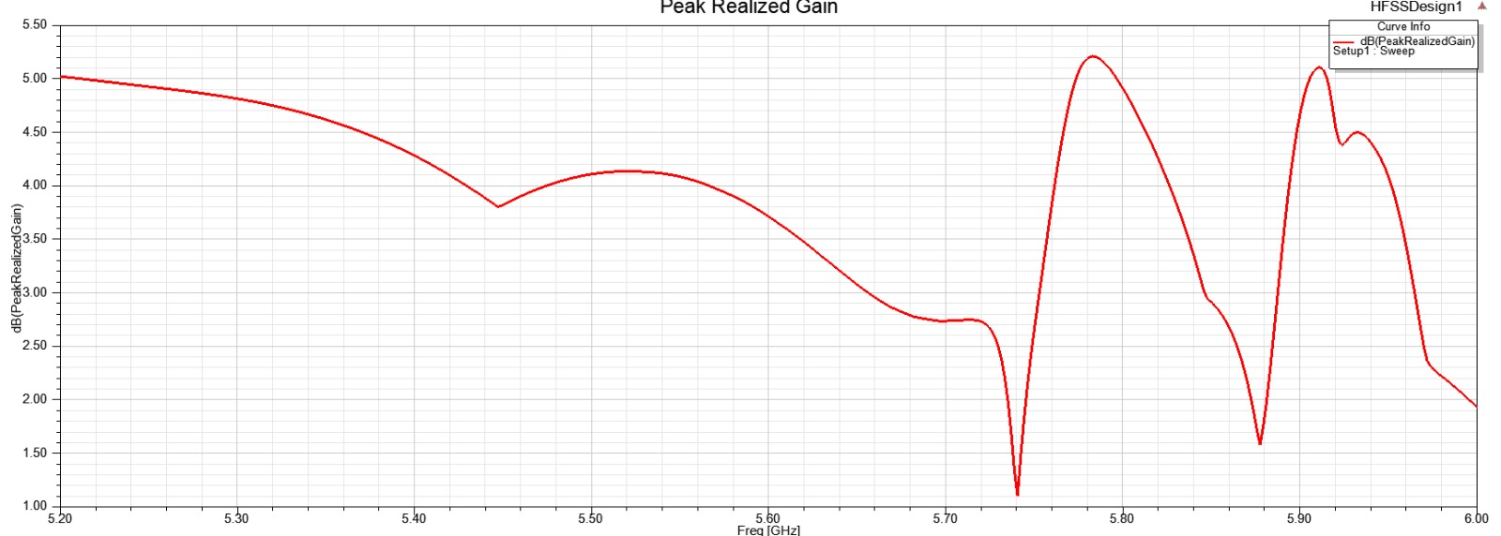
METAL vs ALUMINA CDRA: GAIN
Metal Patch (FR-4, εr = 4.4)
Alumina CDRA (εr = 9.8)

Slide 11
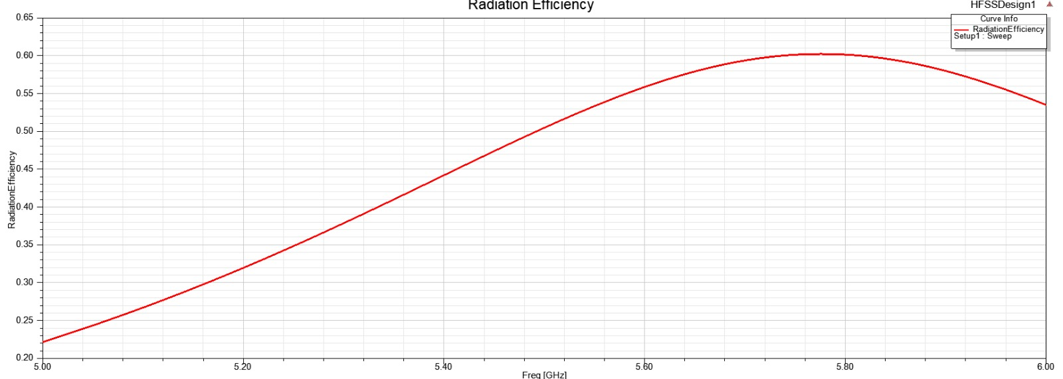
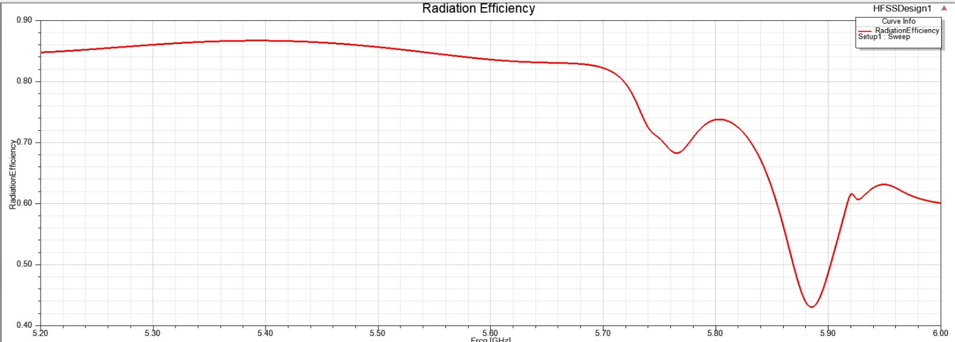
METAL vs ALUMINA CDRA: RADIATION EFFICIENCY
Metal Patch (FR-4, εr = 4.4)
Alumina CDRA (εr = 9.8)
Q1: Metal Patch vs Alumina CDRA at 2.40 GHz

Slide 12
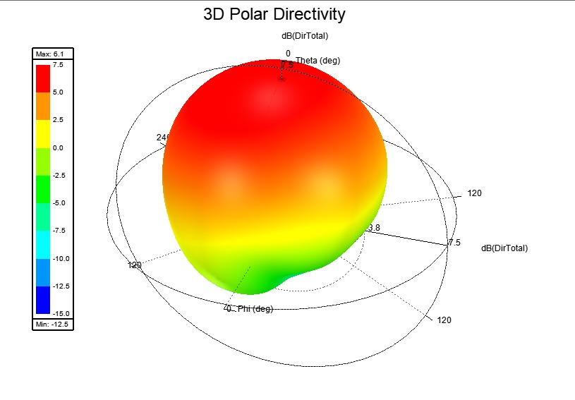
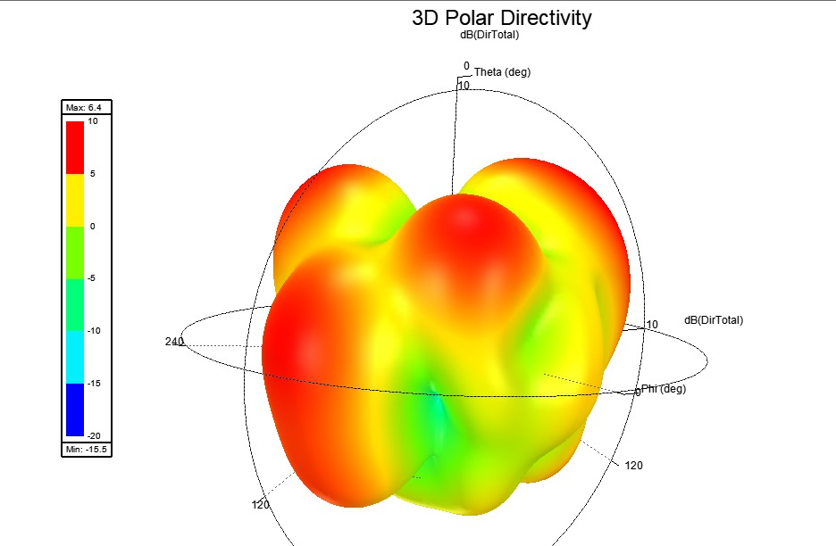
METAL vs ALUMINA CDRA: DIRECTIVITY(3D)
Metal Patch (FR-4, εr = 4.4)
Alumina CDRA (εr = 9.8)

Slide 13
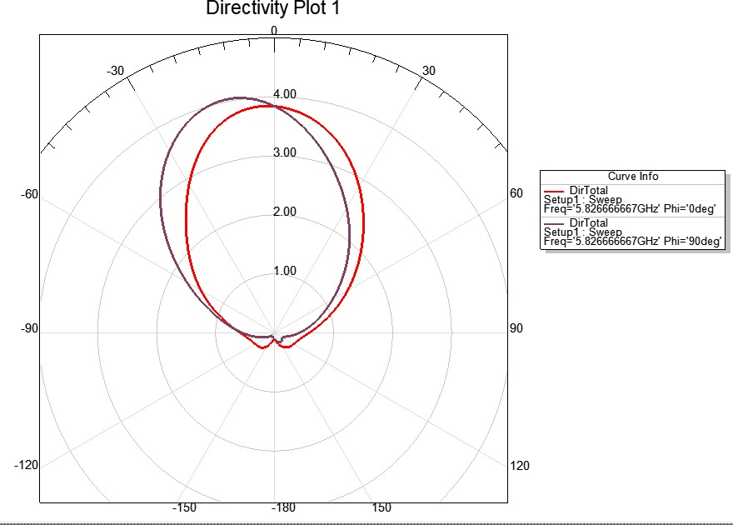
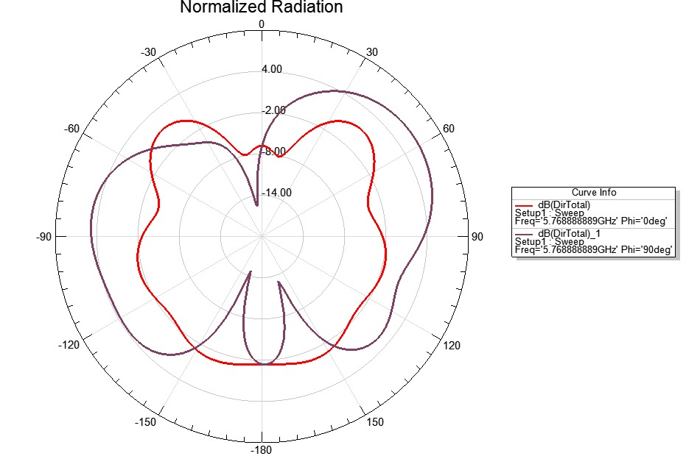
METAL vs ALUMINA CDRA: DIRECTIVITY(2D)
Metal Patch (FR-4, εr = 4.4)
Alumina CDRA (εr = 9.8)

Slide 14
METAL vs ALUMINA CDRA: SUMMARY TABLE
Parameter | Metal Patch | Alumina CDRA
Radiation mechanism | Conduction currents | Displacement currents
Radiator material (εr) | Copper on FR-4 (4.40) | Alumina (9.8)
Resonant frequency | 5.826 GHz | 5.76 GHz
S₁₁ at resonance | -15.95 dB | -25.07 dB
VSWR | 1.5 | 1.2
Peak realized gain | 3.80 dB | 5.40 dB
Radiation Efficiency | 60% | 72%

Slide 15
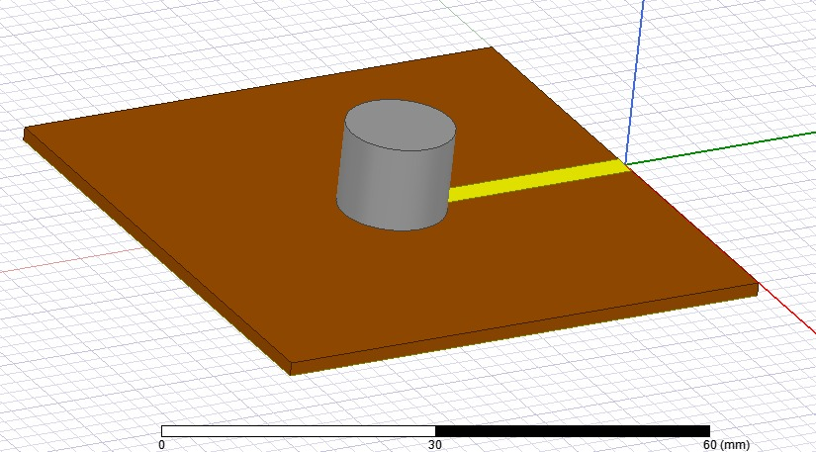
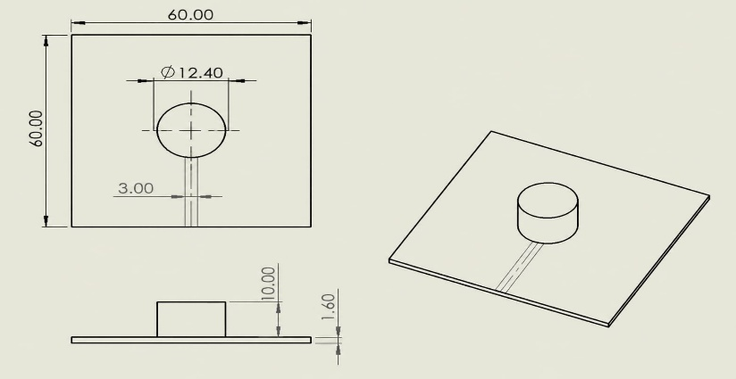
ZIRCONIA CDRA: MATERIAL & GEOMETRIC DESIGN
Why Zirconia (ZrO₂)?
Zirconia has a relative permittivity of εr ≈ 23, about 3.06× that of Alumina (εr = 9.8). Since λg ∝ 1/√εr, the linear size can shrink at 1.75× at 5.80 GHz enabling strong volumetric miniaturization.
Same CDRA Geometry
The Zirconia CDRA keeps the cylindrical geometry of the Alumina CDRA, so only the material changes. Higher permittivity is expected to shrink the resonator but narrow the impedance bandwidth (size-bandwidth trade-off).
THE HFSS SIMULATION MODEL
Design Parameter | Zirconia CDRA
Relative Permittivity (εr) | ≈23
Dielectric Loss Tangent | 0.001
Geometric Profile | 6.2mm x 10mm
Target Resonant Frequency | 5.80 GHz
DIMENSIONED VIEWS OF THE ZIRCONIA CDRA (MM)

Slide 16
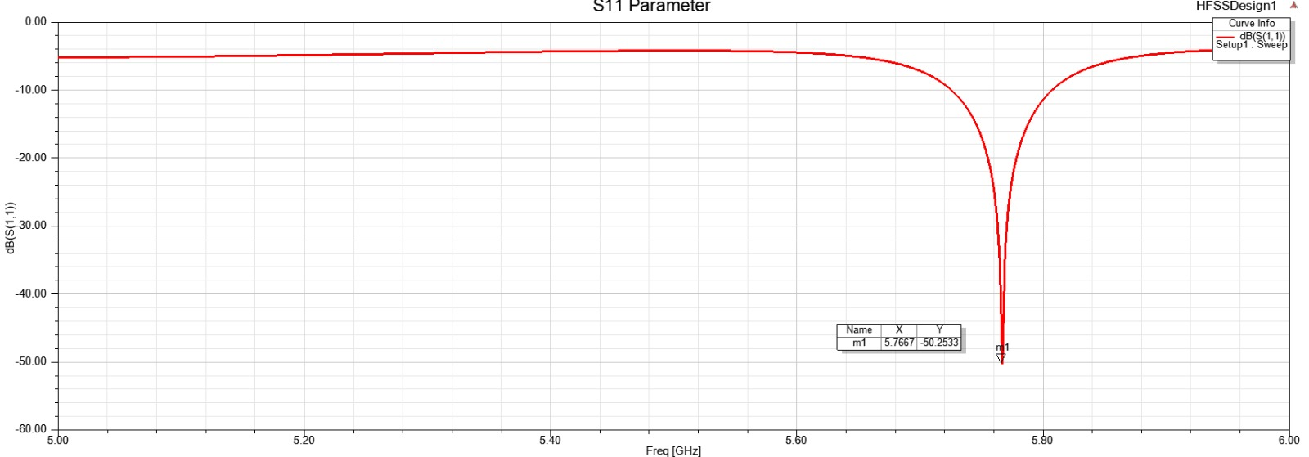
ALUMINA vs ZIRCONIA CDRA: S11
Alumina CDRA (εr = 9.8)
Zirconia CDRA (εr ≈ 23)

Slide 17
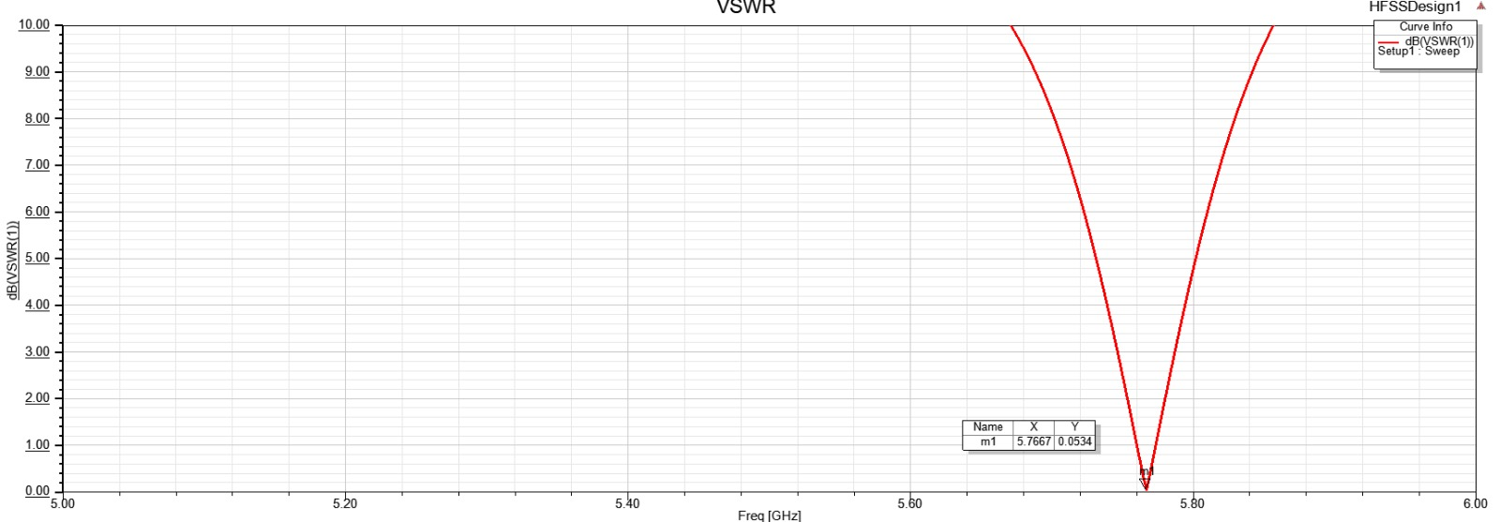
ALUMINA vs ZIRCONIA CDRA: VSWR
Alumina CDRA (εr = 9.8)
Zirconia CDRA (εr ≈ 23)

Slide 18
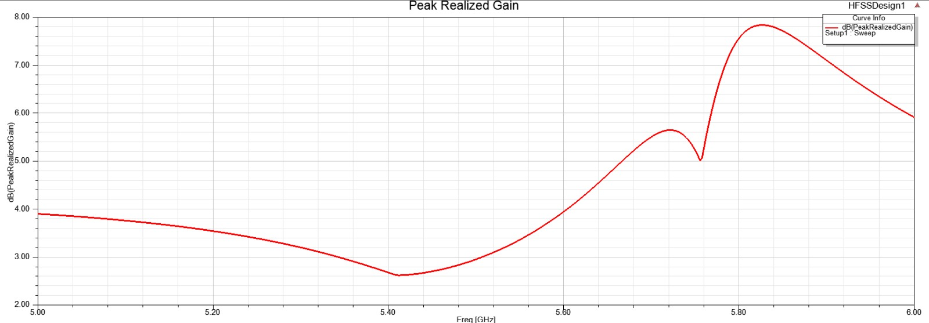
ALUMINA vs ZIRCONIA CDRA: GAIN
Alumina CDRA (εr = 9.8)
Zirconia CDRA (εr ≈ 23)

Slide 19
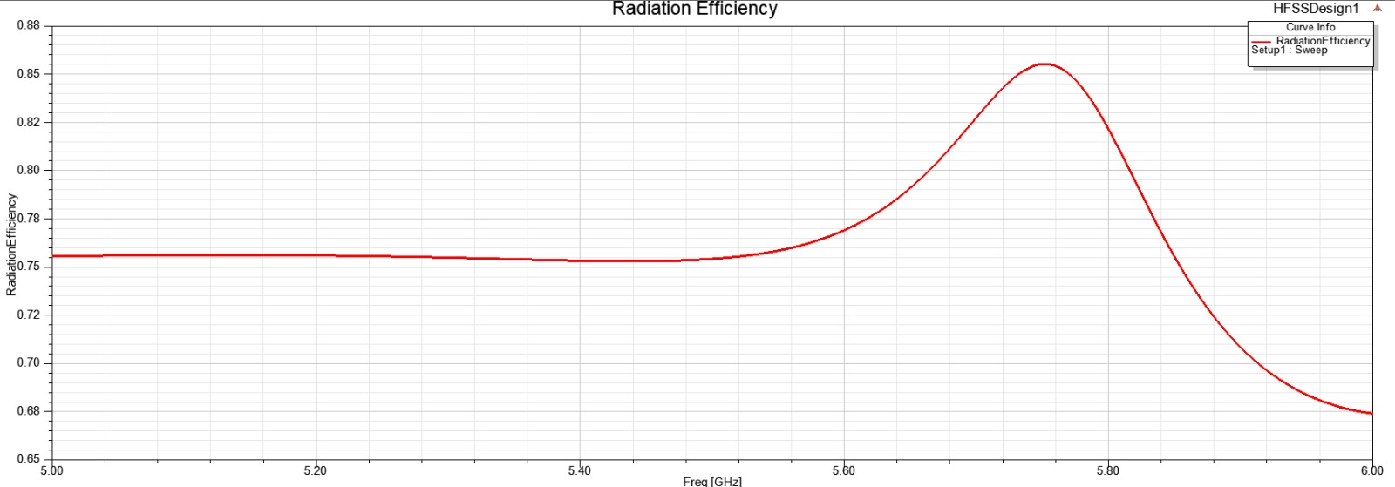
ALUMINA vs ZIRCONIA CDRA: RADIATION EFFICIENCY
Alumina CDRA (εr = 9.8)
Zirconia CDRA (εr ≈ 23)

Slide 20
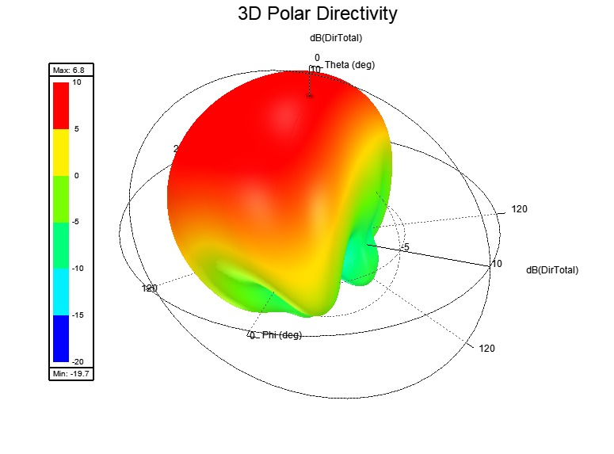
ALUMINA vs ZIRCONIA CDRA: DIRECTIVITY(3D)
Alumina CDRA (εr = 9.8)
Zirconia CDRA (εr ≈ 23)

Slide 21
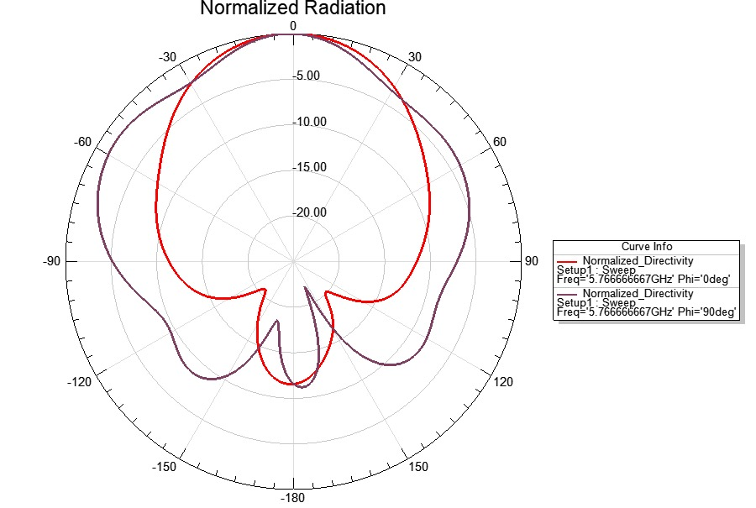
ALUMINA vs ZIRCONIA CDRA: DIRECTIVITY(2D)
Alumina CDRA (εr = 9.8)
Zirconia CDRA (εr ≈ 23)

Slide 22
ALUMINA vs ZIRCONIA CDRA: SUMMARY TABLE
Parameter | Alumina CDRA | Zirconia CDRA
Relative permittivity (εr) | 9.8 | ≈23
Resonant frequency | 5.76GHz | 5.76GHz
S₁₁ at resonance | -25.07 dB | -50.25dB
VSWR | 1.2 | 0.1
Peak realized gain | 5.40 dB | 7.75 dB
Radiation efficiency | 72% | 88%

Slide 23
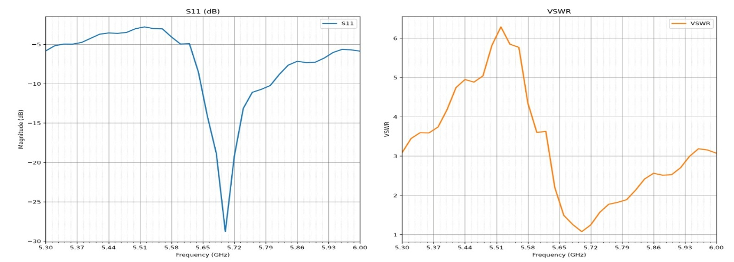
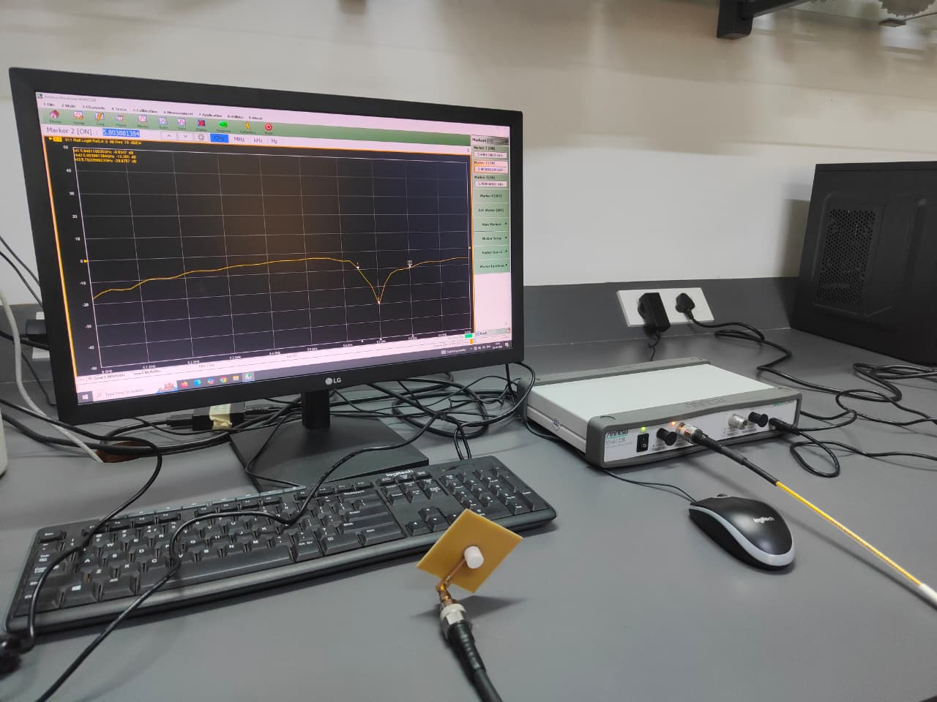
ZIRCONIA CDRA : PRACTICAL OUTPUTS
S11 and VSWR
Zirconia CDRA S11 checking on VNA

Slide 24


CONCLUSION & FUTURE RESEARCH SCOPE
Sequential Research Conclusions
Future Scope & Research Trajectory
Analysis of Metal Patch: Analysis of circular metallic patch antenna, it was observed that S11 occurred at 2.4GHz at -11.76dB with a gain of +2.5 dB
Fabrication & Anechoic Validation: CNC milling, sintering and anechoic-chamber testing of the ceramic CDRAs.
Differential Feed Optimization: Implementing differential feeding networks to further suppress cross-polarization below -25 dB.
Alumina CDRA vs Metal Patch: Displacement currents replace ohmic conduction loss; the S₁₁, gain and efficiency change is quantified in Q1.
AI/ML Surrogate Synthesis: Utilizing ANN and XGBoost models to rapidly synthesize geometry parameters without extensive 3D EM sweeps.
Zirconia vs Alumina CDRA: Raising εr from 9.8 to ≈23 cuts linear size to ≈0.57× (theory); simulated gain increases from 5.4dB to 7.75dB
Design of Parasitic Element Zirconia DRA: Adding a ring around the Zirconia CDRA to see any change in behaviour of the antenna
"The study demonstrates that both the choice of radiating structure (dielectric vs. metal) and the selection of dielectric material (Zirconia vs. Alumina) play vital roles in achieving ultra-compact and highly efficient wireless antenna performance."

Slide 25
REFERENCES
[1] M. Mukherjee, S. Chatterjee, and S. Biswas, “Review of dielectric resonator antenna characteristics and applications,” IEEE Access, vol. 8, pp. 123456–123470, 2020.
[2] S. K. Mishra and R. K. Chaudhary, “Study of dielectric materials for dielectric resonator antennas,” Progress In Electromagnetics Research, vol. 58, pp. 45–52, 2016.
[3] A. Sharma and D. Gupta, “Design and analysis of rectangular dielectric resonator antenna using HFSS,” International Journal of Electronics and Communication Engineering, vol. 12, no. 4, pp. 210–215, 2018.
[4] P. Kumar and M. Singh, “Wideband high-gain dielectric resonator antenna using higher-order modes,” IEEE Antennas and Wireless Propagation Letters, vol. 18, no. 6, pp. 1150–1154, 2019.
[5] R. Verma and S. Tiwari, “Enhanced gain and bandwidth of dielectric resonator antenna using hollow structure,” Microwave and Optical Technology Letters, vol. 62, no. 3, pp. 980–985, 2020.
[6] N. Patel and V. Shah, “Dielectric ring resonator antenna for millimeter-wave applications,” International Journal of RF and Microwave Computer-Aided Engineering, vol. 30, no. 5, e22145, 2020.
[7] J. Lee, H. Kim, and S. Park, “Advanced dielectric resonator antennas for 5G and 6G communication systems,” IEEE Transactions on Antennas and Propagation, vol. 72, no. 1, pp. 45–55, 2024.
[8] A. Roy, K. Das, and P. Sen, “Machine learning based circularly polarized dielectric resonator antenna for ultra-wideband applications,” Scientific Reports, vol. 15, no. 33605, 2025.

Slide 26
Thank you

